Slide 1
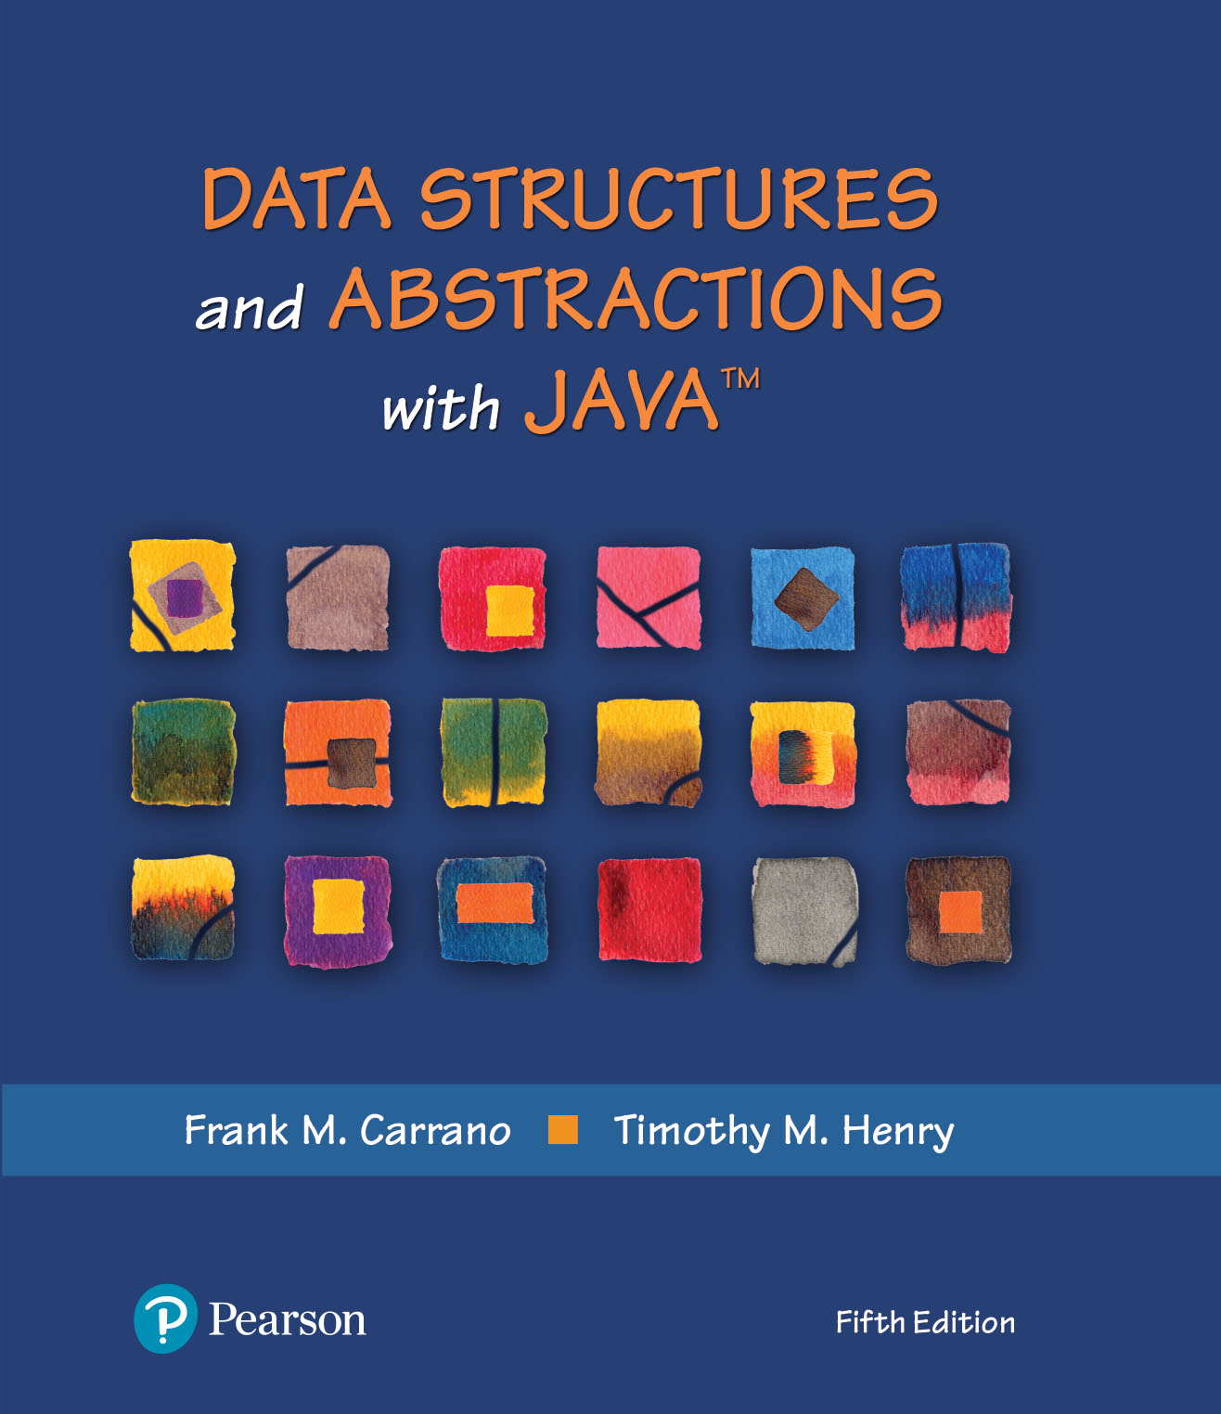
Module 6
Efficiency of Algorithms (Chapter 4)

Slide 2
Video Notes
Measuring Efficiency
https://mediaplayer.pearsoncmg.com/assets/secs-vn-ch04a-measuring-efficiency
Comparing Bag Implementations
https://mediaplayer.pearsoncmg.com/assets/secs-vn-ch04b-comparing-bag-implementations
Notes:
To maximize your learning experience, prepare for class prior each week

Slide 3
Additional Resources
Introduction to Big O Notation and Time Complexity
https://www.youtube.com/watch?v=D6xkbGLQesk&feature=youtu.be
https://www.youtube.com/watch?v=bum_19loj9A&list=PLBZBJbE_rGRV8D7XZ08LK6z-4zPoWzu5H
Big O Quadratic Time Complexity
https://jarednielsen.com/big-o-quadratic-time-complexity/
Big O Notation - explained as easily as possible
https://thatcomputerscientist.com/big-o-notation-explained-as-easily-as-possible
Analysing Algorithms: Worst Case Running Time
https://thatcomputerscientist.com/analysing-algorithms-worst-case-running-time
Notes:
To maximize your learning experience, prepare for class prior each week

Slide 4
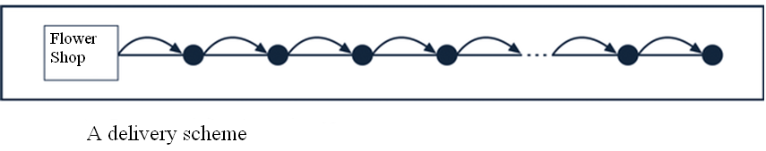
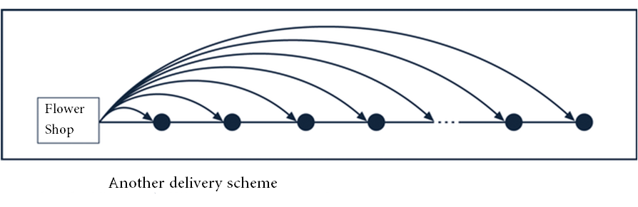

Trade Off Analysis
A flower shop has multiple deliveries to make. What algorithm should they use?
Notes:
No matter what we do, we try to be effective about it
Same expectation in programming
What are the trade-offs?

Slide 5
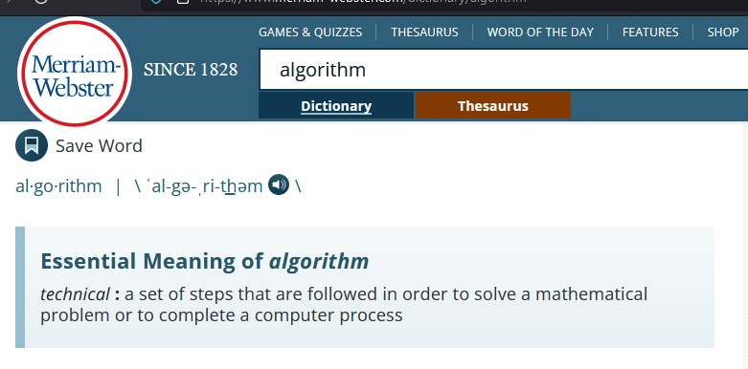
What’s an Algorithm?
https://www.merriam-webster.com/dictionary/algorithm
Notes:
To maximize your learning experience, prepare for class each week
https://www.merriam-webster.com/dictionary/algorithm

Slide 6
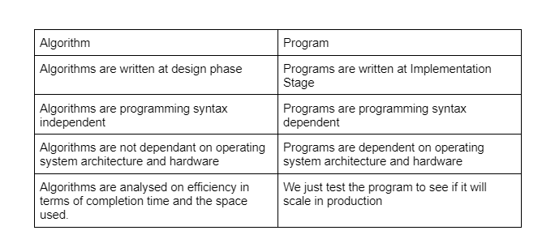
Algorithm
https://levelup.gitconnected.com/algorithms-3bd92fa4155f
Notes:
To maximize your learning experience, prepare for class each week

Slide 7
Algorithm
Algorithm is evaluated based on two characteristics: the time and the space the algorithm uses as a function of the dataset's size
These are known as the Time Complexity and Space Complexity respectively
Algorithms
https://levelup.gitconnected.com/algorithms-3bd92fa4155f
Performance of an algorithm
Big O Notation

Slide 8
Code Expectations
What are the expectations thus far?
Code efficiency
How do we measure efficiency?
Space vs. time analysis
What’s more important, time vs. space and why?
Computers are faster, have larger memories
Should we still worry about code efficiency?
N : Number of elements (amount of data)
CMSC203: 0 <= n <= 50
CMSC204: Think Big Data
Don’t overlook readability
Notes:
Don’t overlook readability. The lifetime of a piece of code could last a decade or longer. Maintenance will become an issue if a piece of code is not easy to read

Slide 9

Importance of Efficiency
Consider the problem of summing (running total)
Algorithm A | Algorithm B | Algorithm C
int sum = 0; for (int i = 1; i <= n; i++) sum = sum + i; | sum = 0; for (int i = 1; i <= n; i++) { for (int j = 1; j <= i; j++) sum = sum + 1; } // end for | sum = n * (n + 1) / 2;
Different approaches to solve the same problem
Which one will run faster? Test them against 1,000,000 elements to find out
Notes:
All 3 algorithms will produce the same result
Algorithm A is the most “intuitive” way (from 140)
Is 1,000,000 elements a “large” dataset? Not really
Critical section of code

Slide 10
Counting Basic Operations
A basic operation of an algorithm
Most significant contributor to its total time requirement
 | Algorithm A | Algorithm B | Algorithm C
 | int sum = 0; for (int i = 1; i <= n; i++) sum = sum + i; | sum = 0; for (int i = 1; i <= n; i++) { for (int j = 1; j <= i; j++) sum = sum + 1; } // end for | sum = n * (n + 1) / 2;
Additons | n | n(n + 1)/2 | 1
Multiplications | 0 | 0 | 1
Divisions | 0 | 0 | 1
Total Basic Operations | n | (n² + n)/2 | 3
Notes:
Algorithm A vs. C
Algorithm C would be the most efficient one, regardless how big n might be

Slide 11
Counting Basic Operations
n | (log(log n) | log n | log² n | n | n log n | n² | n³ | 2^{n} | n!
10 | 2 | 3 | 11 | 10 | 33 | 10² | 10³ | 10³ | 10⁵
10² | 3 | 7 | 44 | 100 | 664 | 10⁴ | 10⁶ | 10³⁰ | 10⁹⁴
10³ | 3 | 10 | 99 | 1,000 | 9,966 | 10⁶ | 10⁹ | 10³⁰¹ | 10¹⁴³⁵
10⁴ | 4 | 13 | 177 | 10,000 | 132,877 | 10⁸ | 10¹² | 10³⁰¹⁰ | 10^{19,335}
10⁵ | 4 | 17 | 276 | 100,00 | 1,660,964 | 10¹⁰ | 10¹⁵ | 10^{30,103} | 10^{243,338}
10⁶ | 4 | 20 | 397 | 1,000,000 | 19,931,569 | 10¹² | 10¹⁸ | 10^{301,301} | 10^{2,933,369}
Algorithm A
Notes:
Different algorithms will yield different results as n gets big
It would be ideal if our method’s growth rate is log(log n) – best case

Slide 12
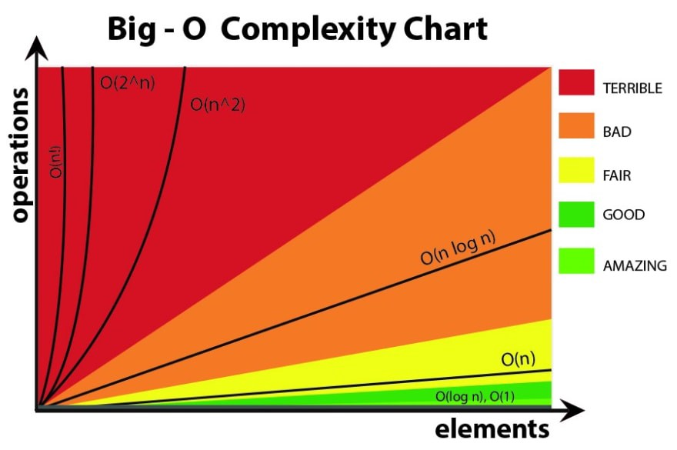
https://jamondixon.medium.com/the-biggest-o-of-them-all-notation-93352775acc7
Notes:
Take a look at the chart, what comes to your mind?
Be sure to check out the article

Slide 13
Picturing Time Efficiency
Growth-Rate Function g | g(10⁶) / 10⁶
log n | 0.0000199 seconds
n | 1 second
n log n | 19.9 seconds
n² | 11.6 days
n³ | 31,709.8 years
2^{n} | 10^{301,016} years
The time required to process one million items by algorithms of various orders at the rate of one million operations per second
Notes:
We should avoid any algorithm (code) with a n² or higher growth rate, if we can help it
Example: we are driving to Miami, which route would you take? 20 vs. 40 hours?

Slide 14
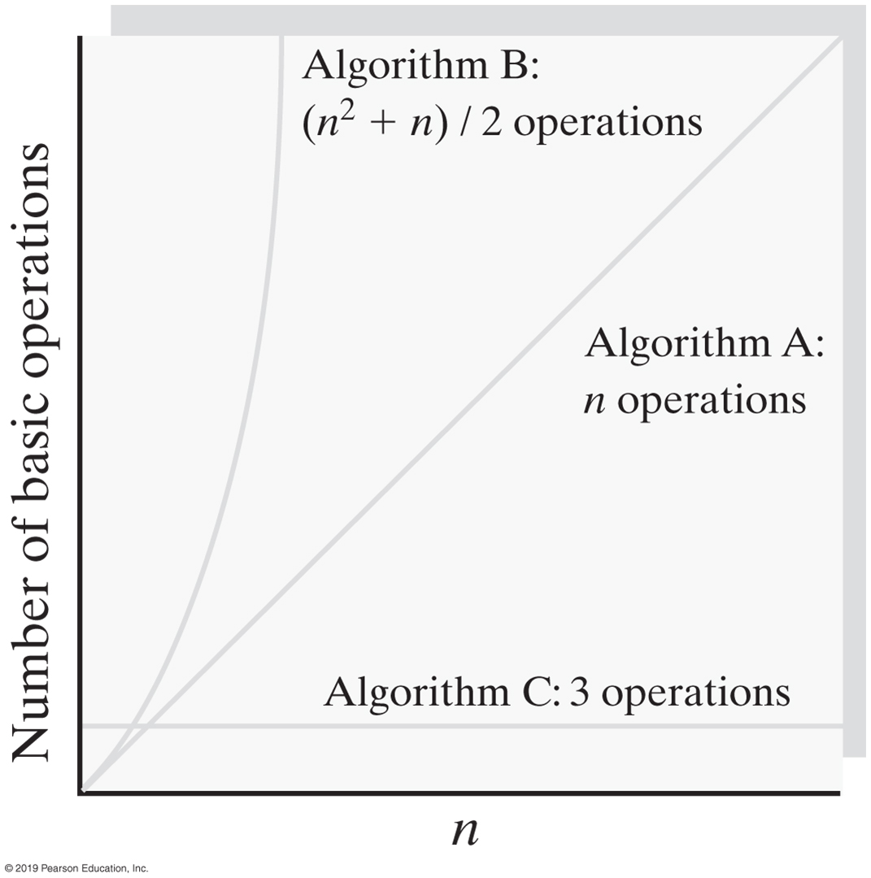
Growth Rates (Running Total)
Notes:
As n gets bigger, here are the expected results
Algorithm C is what you want (as n gets bigger, it’s still VERY efficient)
Big O – Order of magnitude

Slide 15
Best, Worst & Average Cases
Goal is to know best, worst and average cases, why?
Best case
Worst case
Average case
For some algorithms, execution time depends only on size of data set
Other algorithms depend on the nature of the data itself
Notes:
Efficiency == thinking about worst case
Murphy’s law

Slide 16
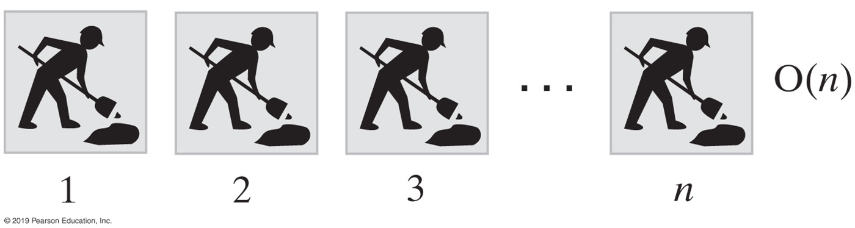
Big O Notation (Picturing Efficiency)
An O(n) algorithm
int sum = 0;
for (int i = 1; i <= n; i++)
sum = sum + i;
Above code depends on n. As n gets big, the function will take n times longer to complete
Notes:
The for loop is depended on n

Slide 17
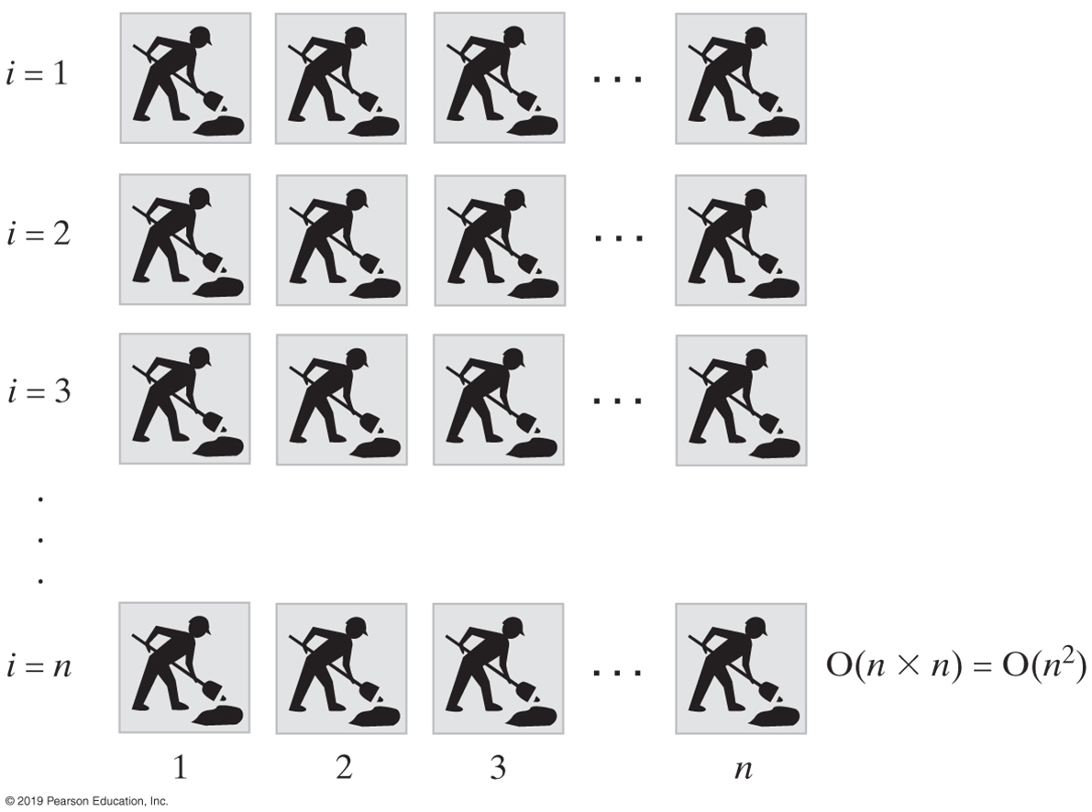
An O(n²) algorithm
sum = 0;
for (int i = 1; i <= n; i++)
{
for (int j = 1; j <= n; j++)
sum = sum + 1;
} // end for
Notes:
O(n*n) vs. 2*O(n)

Slide 18
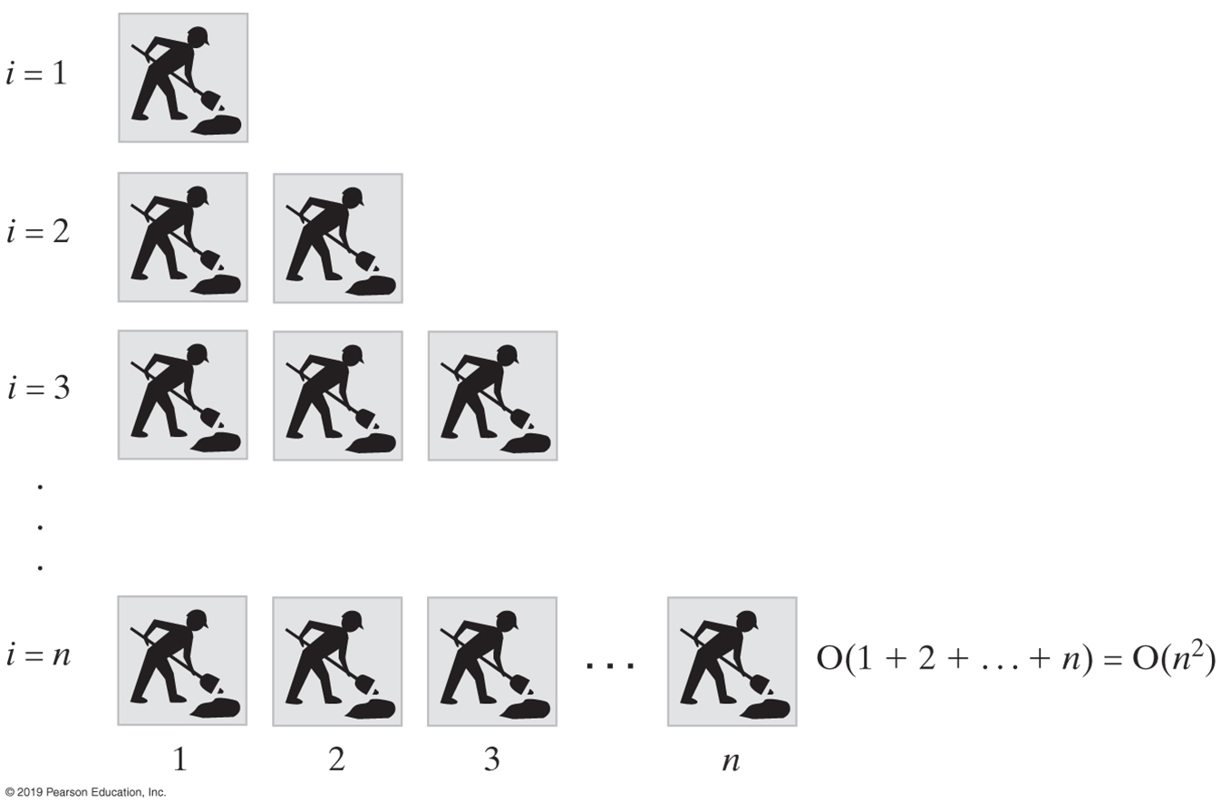
Another O(n²) algorithm
sum = 0;
for (int i = 1; i <= n; i++)
{
for (int j = 1; j <= i; j++)
sum = sum + 1;
} // end for
Notes:
Both loops depend on n

Slide 19
More Examples

Slide 20
Constant - O(1)
O(1) describes an algorithm that will always execute in the same time (or space) regardless of the size of the input data set
bool IsFirstElementNull(String[] strings)
{
if(strings[0] == null)
{
return true;
}
return false;
}
Rob Bell
A beginners Guide to Big O Notation
rob-bell.net/2009/06/a-beginners-guide-to-big-o-notation/
Notes:
O(1) annotates “the same” as n grows
We say O(1) as oppose to O(5)

Slide 21
Linear - O(n)
Example illustrates how Big O represents the worst-case performance scenario
Even though a matching string could be found during any iteration of the for loop and the function would return early, Big O (notation) will always assume the upper limit where the algorithm will perform the maximum number of iterations
bool ContainsValue(String[] strings, String value)
{
// additional logics before and after this critical section
for(int i = 0; i < strings.Length; i++)
{
if(strings[i] == value)
{
return true;
}
} return false;
}
Rob Bell
A beginners Guide to Big O Notation
rob-bell.net/2009/06/a-beginners-guide-to-big-o-notation/

Slide 22
Polynomial - O(n²)
An algorithm whose performance is directly proportional to the square of the size of the input data set. This is common with algorithms that involve nested iterations over the data set. Deeper nested iterations will result in O(n³), O(n⁴) etc.
bool ContainsDuplicates(String[] strings) {
for(int i = 0; i < strings.Length; i++)
{
for(int j = 0; j < strings.Length; j++)
{
if(i == j) // Don't compare with self
{
continue;
}
if(strings[i] == strings[j])
{
return true;
}
}
}
return false;
}
Rob Bell
A beginners Guide to Big O Notation
rob-bell.net/2009/06/a-beginners-guide-to-big-o-notation/

Slide 23
Exponential - O(2^{n})
int Fibonacci(int n)
{
if (n <= 1)
return n;
else
return Fibonacci(n - 1) + Fibonacci(n - 2);
}
Growth will double with each additional element in the input data set. The execution time of an O(2^{N}) function will quickly become very large
Recursive calculation of Fibonacci numbers
Rob Bell
A beginners Guide to Big O Notation
rob-bell.net/2009/06/a-beginners-guide-to-big-o-notation/

Slide 24
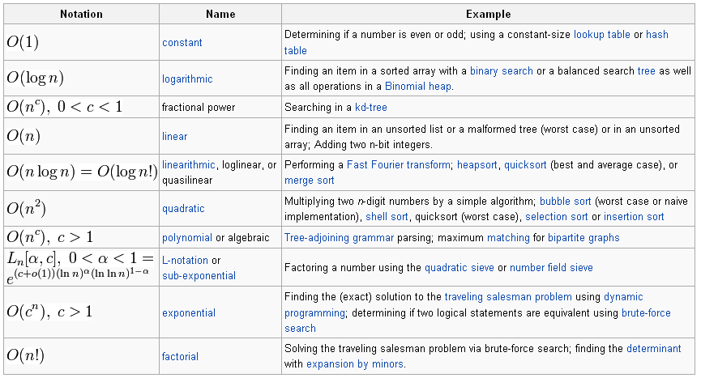
Orders of Common Functions
From Wikipedia, the free encyclopedia
Notes:
Most methods that we implement will likely be one of the above common functions

Slide 25
Algorithm Speed Analysis Technique
Identify the most critical section of code, look for the inner most nested loop
Determine the maximum number of times this loop executes as a function of n, the maximum value of the loop variable(s)
For data structures, n is often the number of nodes in the structure
Big-Oh value of the function is the relative speed
Example: Binary search algorithm is O(log n)

Slide 26
Binary Search
Generalizing T = log2n

Slide 27
Binary Search
low = 0;
high = n - 1
i = (high - low) / 2;
while (searchValue != data[i] && high != low)
{ if(searchValue < data[i])
{ high= i - 1 } // move high down to eliminate the upper half of the sub-array
else
{ low = i + 1 } // move low up to eliminate the lower half of the sub list
i = (high + low) / 2;
}
If n is the size of the array, the while loop executes a maximum of log₂(n-1) times

Slide 28
Efficiency of ADT Bag
Operation | Fixed-Size Array | Linked
add(newEntry) | O(1) | O(1)
remove() | O(1) | O(1)
remove(anEntry) | O(1), O(n), O(n) | O(1), O(n), O(n)
clear() | O(n) | O(n)
getFrequencyOf(anEntry) | O(n) | O(n)
contains(anEntry) | O(1), O(n), O(n) | O(1), O(n), O(n)
toArray() | O(n) | O(n)
getCurrentSize(), isEmpty() | O(1) | O(1)
The time efficiencies of the ADT bag (or any ADT) operations for two implementations, expressed in Big Oh notation
Notes:
Why is it important to understand at the method level?
Different ADTs serve different purposes. What do I mean? Google, search vs. sorted

